Slide 1
Open a New Window of Plasma Diagnostics in the Solar Physics with Spectropolarimetric Observation
HINODE SEMINAR@ISAS
June 10th, 2014
Tetsu Anan (Kyoto university)
Roberto Casini (HAO), Kiyoshi Ichimoto (Kyoto univ.),
and members of Hida observatory
Notes:
Hello everyone. My name is Tetsu Anan. I work at Kyoto University, Japan.
I will take PhD degree in May 2014, and I applied for postdoctoral position in Solar physics at the Max Planck Institute for Solar System research.
Today, I would like to talk about my PhD thesis and what I want to do if I will be in postdoctoral position here.

Slide 2
Chromosphere
Magnetic energy stored in photosphere is transferred into the heliosphere through dynamic phenomena in chromosphere as wave and magnetic structure
Dominant energy: Internal energy => Magnetic energy
Wave mode conversion
Dynamic phenomena couple with magnetic structure
=> Importance to study roles of chromosphere in energy transfer
Chromosphere is partially ionized
NAOJ/JAXA
2/43

Slide 3
Dynamics of partially ionized plasma and magnetic field
Ion and electron
B
e
i
i
e
e
i
3/43

Slide 4
Dynamics of partially ionized plasma and magnetic field
Neutral atom
B
n
n
n
4/43

Slide 5
Dynamics of partially ionized plasma and magnetic field
Ion, electron, and neutral atom
B
e
n
i
i
n
Electric field experienced by neutral atom
e
e
i
n
Velocity difference between neutral atom and charged particle
is important for diffusion of magnetic field and wave
5/43

Slide 6
Electric field
Transformation of inertial frame
E field
accelerates charged particle => particle acceleration
diffuses magnetic field => magnetic reconnection
Plasma
Observer
Observables
Induction equation
6/43
Notes:
プラズマ慣性系における電場が０のとき、プラズマは磁場に凍結

Slide 7
Electric field experienced by neutral atom
E field experienced by charged particle frozen in B field
E field experienced by neutral atom
Plasma
Observer
Plasma
Observer
Measurement of E field experience by neutral atom => Velocity difference between neutral atom and charged particle
7/43

Slide 8
Chromosphere
Magnetic energy stored in photosphere is transferred into the heliosphere through dynamic phenomena in chromosphere
Dominant energy : Internal energy => Magnetic one
To understand role of chromosphere, magnetic field structure and relation between plasma dynamics and magnetic field are important
Measurement of magnetic and electric fields clear the relation between dynamics and magnetic field in partially ionized plasma (chromosphere)
8/43

Slide 9
Polarization process in spectral line
M = 1
M = 0
M = −1
J = 1
Quantization
axis
J = 0, M = 0
λ
9/43

Slide 10
Polarization process in spectral line Zeeman effect
M = 1
B
M = 0
J = 1
M = −1
Quantization
axis
J = 0, M = 0
λ
10/43

Slide 11
Polarization process in spectral line Stark effect
M = 1/2
M = −1/2
E
M = 3/2
M = −3/2
J = 3/2
Quantization
axis
J = 1/2
M = −1/2
M = 1/2
λ
11/43

Slide 12
Atomic polarization
Alignment
Orientation
J = 1
J = 1
M = 1
M = 0
M = −1
M = 1
M = 0
M = −1
J = 0, M = 0
J = 0, M = 0
Population imbalance
between different |M|
Population imbalance
between +M and −M
12/43

Slide 13
Polarization process in spectral line Resonance scattering
Absorption
Emission
atom
atom
Time scale 〜 1/A
Incident light
Scattered radiation is polarized perpendicular to scattering plane
13/43
Notes:
Resonance scattering

Slide 14
Polarization process in spectral line Resonance scattering, Atomic alignment
M = 1
M = 0
M = −1
J = 1
Quantization
axis
J = 0, M = 0
Incident
radiation
λ
14/43

Slide 15
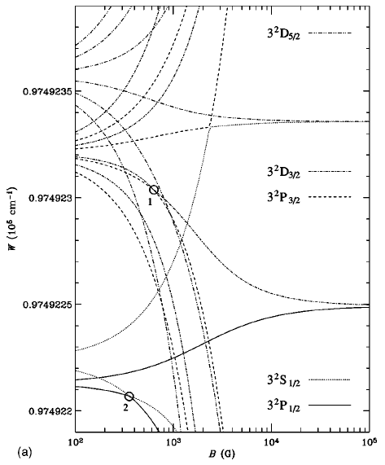
Efficiency of scattering polarization
Energy configuration of Hydrogen
It depends on angular quantum number of upper and lower level
Paschen-Back effect and Stark effect change energy configuration
=> change the efficiency of scattering polarization
E. Landi Degl’Innocenti & M. Landolfi 2004
W (cm⁻¹)
E ( 1 V/cm ) ∥ B
(J is not good quantum number, when B or E fields strong)
10²
10³
10⁴
10⁵
B (G)
Casini 2005
15/43
Notes:
Strong B and E field chane the effeciency of the generation of the linear polarization by scattering
The efficiency depends on angular quantum number of upper and lower level.
In L-S coupling and no external field case, the efficiency can be written as
In Strong field case, Paschen-Back effect and Stark efect change energy configulation of the atom
The plot shows the energy configuration of hydrogen.
Some level crossing and coupling
In the regime, J is not good quantum number
Thus the efficiency of the scattering change.
式（10.11）
円は違うLが重なる点、電場によって違うLもインタラクション？

Slide 16
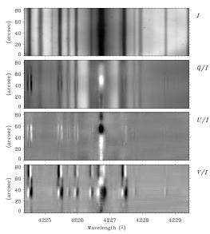
Hanle effect
Ca I 4227Å
Rotation and depolarization
of the plane of polarization
in the line core by B field
Intensity
−
+
B
+
atom
−
+
−
Stenflo
16/43
Notes:
Zeeman effect
Linear polarization is constant along the slit without B field, because Solar radius
By the way

Slide 17
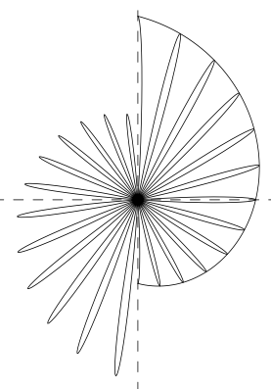
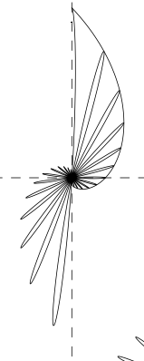
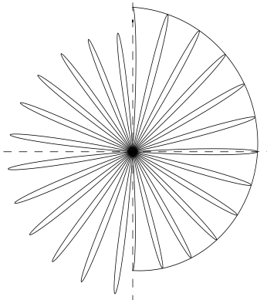
Measurement of magnetic field by Hanle effect
Precession of the oscillator
around the B field
Q U
ω_{L}/A
0.1
1
5
( =eB/m/c/A )
17/43
Notes:
The depolarization and rotation of the linear polarization depend on the ratio between Larmor frequency and Einstein A coefficient.
3 pictures show the precession of the oscillator in excited state around the B field
Time scale of the precession is 1/ωL
Time scale of the excited state of 1/A

Slide 18
Polarization process in spectral line Alignment-to-Orientation conversion (AO)
M = 1
Alignment
M = 1
M = 0
M = −1
J = 1
J = 0, M = 0
Incident
radiation
18/43
Notes:
Deexciteする確立が違えば偏る！！

Slide 19
Polarization process in spectral line Alignment-to-Orientation conversion (AO)
Alignment=>Orientation
M = 1
Alignment
M = 1
M = 0
M = −1
J = 1
Interference
J = 0, M = 0
Incident
radiation
19/43
Notes:
Deexciteする確立が違えば偏る！！

Slide 20
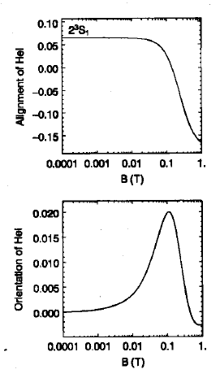
Polarization process in spectral line Alignment-to-Orientation conversion
AO in HeI 2³S₁
AO in both B and E tend to be larger that in only B
B : Level crossing between ΔJ
E : Level crossing between ΔL
0.1
0.0
Linear
polarization
Alignment
−0.1
Casini 2005
Orientation, HI 2²S_{1/2}
1
10
100
1000
10000
B (G)
Orientation
Without E
0.020
Circular
polarization
0.010
Orientation
With E = 1 V/cm
0.000
Orientation
1
10
100
1000
10000
Fujimoto
1
10
100
1000
10000
B (G)
Fujimoto & Iwamae 2008
B (G)
20/43
Notes:
Strong B and E field chane the effeciency of the generation of the linear polarization by scattering
The efficiency depends on angular quantum number of upper and lower level.
In L-S coupling and no external field case, the efficiency can be written as
In Strong field case, Paschen-Back effect and Stark efect change energy configulation of the atom
The plot shows the energy configuration of hydrogen.
Some level crossing and coupling
In the regime, J is not good quantum number
Thus the efficiency of the scattering change.
式（10.11）
円は違うLが重なる点、電場によって違うLもインタラクション？

Slide 21
Polarization process in spectral line
Landi Degl’Innocenti and Landolfi 2004, Casini 2005
 | Polarization process
Energy splitting | Zeeman effect B
 | Stark effect E
Atomic polarization | Scattering Radiation (R)
 | Hanle effect R + B or E
 | Alignment – Orientation R + B or E
λ
21/43
Notes:
Here I’d like to introduce general polarization process in spectral line
Before introduce the table, I would like to explain energy splitting and atomic polarization by using simple atomic model.
This is upper level, and this is lower level. Energy is high and low.
J is total angular momentum quantum number, and M is magnetic quantum number.
Blue circles denote population of atom whose electron is on the sub-states.
Transition of electron state from upper energy level to lower energy level produces photon whose polarization depends on the difference of magnetic quantum numbers.

Slide 22
Measurement of magnetic field in chromosphere
Polarization degree
Quiet region
Active region
0.1
Zeeman effect
（Longitudinal）
0.01
Hanle effect
Zeeman effect
（Transversal）
0.001
Detection limit
0.1
1
10
100
1000
10000
Magnetic field strength（G）
eg. J.O.Stenflo, 2001
Zeeman and Hanle effect => B field in chromosphere
22/43

Slide 23
Measurement of electric field
Around 1990s, some observations to measure E field
(Linear) Stalk effect
works on hydrogen-like ion
produces only linear polarization (no circular polarization)
=> They observed linear polarization in high n HⅠ lines
Assumption of no atomic polarization
Foukal & Behr (1995) measured E field of a surge 〜35 V/cm
Casini (2005) developed a formalism in the B & E fields for HⅠ lines with consideration of atomic polarization
The atomic polarization produces circular polarization
E 〜0.1 V/cm modulate the polarization
Estimated E field in prominence 〜 0.16 V/cm (Gilbert et al. 2002)
(Foukal & Hinata 1991)
23/43
Notes:
Around 1990s some observations were carried out to measure electric field
They use Linear Stark effect which works on hydrogen-like ion and produce only linear polarization.
They assumed no atomic polarization.
Foukal & Behr measured Electric field of a surge of 35 V/cm. Surge is target of our thesis.
Casini developed a formalism in the magnetic and electric fields for hydrogen lines and includes atomic polarization.
The atomic polarization produces circular polarization.
In this decade, there are no observation to measure electric field.

Slide 24
Developments of the wideband spectropolarimeter of the Domeless Solar Telescope at Hida Observatory
Anan et al. 2012, SPIE

Slide 25
Developments of spectropolarimeter
Science
Diagnosis of magnetic fields in chromosphere
Open a new window of plasma diagnostics
Stark effect => Electric field
Impact polarization => Non-thermal particles
Basic physics of atomic polarization
Instrument
Wide range of wavelength (4000 - 11000 Å)
Polarimetric sensitivity (10⁻³ - 10⁻⁴)
25/43
Notes:
To measure magnetic field in chromosphere, open a electric field diagnostics,
We developed a spectropolarimeter of Domeless Solar Telescope at Hida Observatory.
The spectropolarimeter provides the full Stokes vector of any spectral regions between 4000 Å and 11000Å for all the spatial points along the spectrograph slit with polarimetric sensitivity 10 to -3 to 10 to -4.

Slide 26
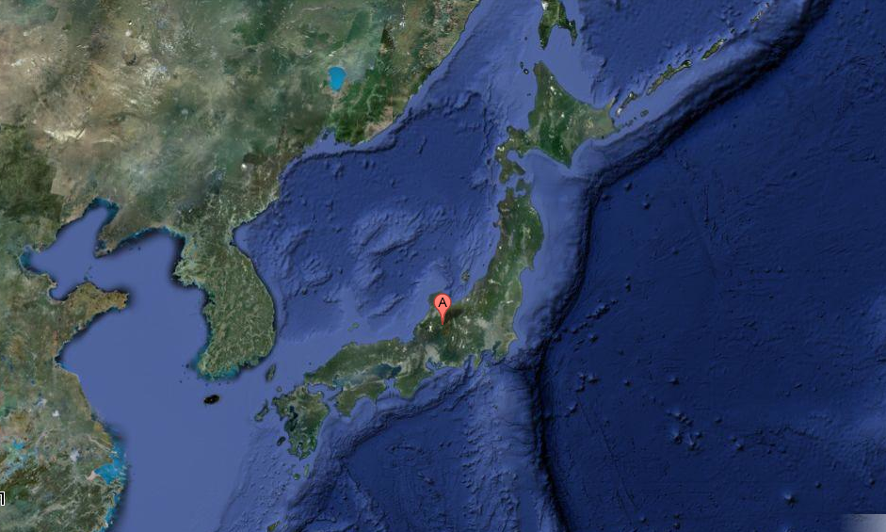
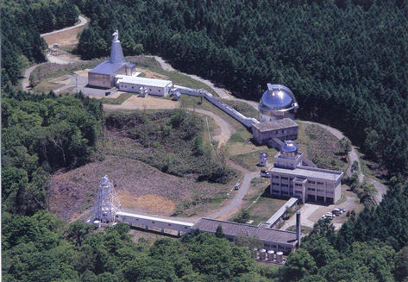
Domeless Solar Telescope (DST) at Hida Observatory
4/27
26/43
Notes:
Hida observatory is almost center of the Japan.

Slide 27
Modulator / Analyzer
Rotating angle θ
I^{obs}₊ (θ、δ)
I^{obs}₋ (θ、δ)
Waveplate
retardation δ
Focus of DST
Wallaston prisms
I^{in}, Q^{in}, U^{in}, V^{in}
Modulation of I^{obs}
27/43
Notes:
Incident polarization IQUV, through into rotating waveplate whose retardation δ with rotating angle θ。
And through into polarimetric beam splitter made from 3 Wallaston prism.
We observe I of orthogonal dual beam.
Observed I is function of θ and δ.
Δ is constant in the wavelength. So observed I is change with rotating angle θ.
The system make IQUV modulation observed I.
We can derive incident IQUV from observing modulation Intensity.

Slide 28
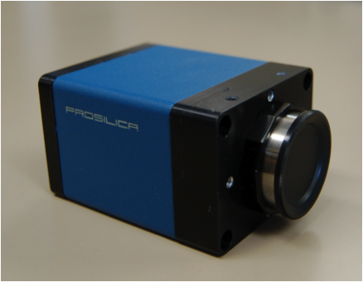
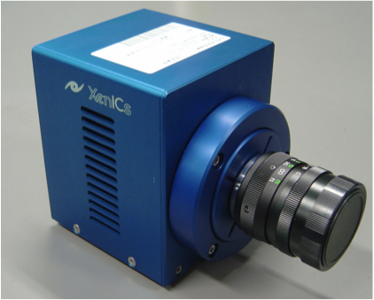
New features of the system Waveplate & Camera
CCD Camera：GE1650
Astropribor Super-Achromatic
True Zero-Order Waveplate
http://astropribor.com/content/view/25/33/
APSAW
Origin sensor
140
130
IR Camera：XEVA640
δ [deg]
120
accuracy of θ ≦ 0.07°
⬄ Error of QUV/I〜10⁻⁴
110
100
200
400
600
800
1000
1200
Wavelength [nm]
30 sec, 16 images
=> 5 sec, 100 images
about 40 times in amount of photon
Waveplate : Quartz => APSAW
Wavelength range: Limited => Wide
28/43
Notes:
Our system is a successor of formerly develped polarimeter on DST.
New features of the system are waveplate and Camera.
We change waveplate from quarts to APSAW. The change makes wavelength range wide, because APSAW have retardation which is effective for modulation for wide wavelength range.
We equip IR camera and fast and large format CCD camera.
These camera make the speed fast, so It takes less than 60sec to achieve photon noise 10^-3.
origin sensor on waveplate works for trigger starting exposing. It make possible taking image with accuracy of rotating angle 0.07deg. It corresponds error of polarization degree 10^-4

Slide 29
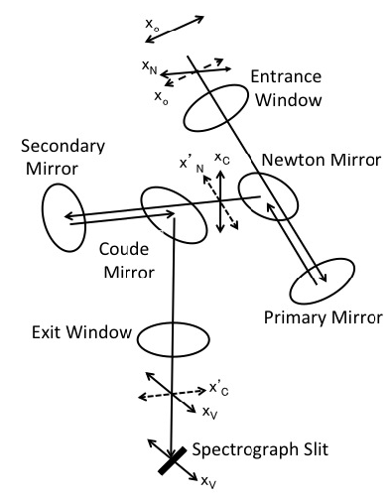
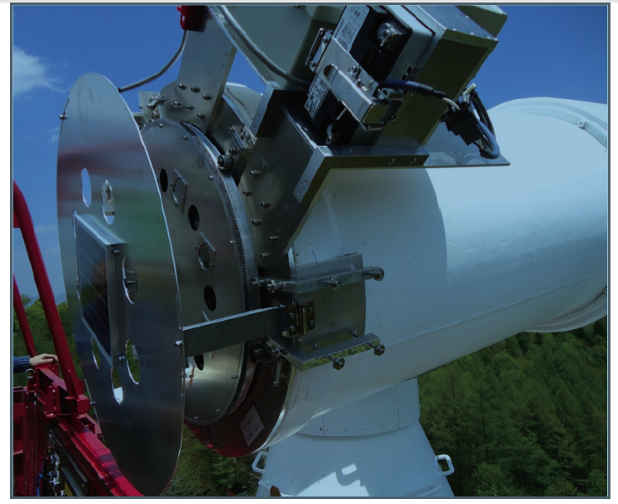
Calibration for instrumental polarization
Instrumental polarization
Calibration
DST Mueller matrix model for 4000Å – 11000Å
Calibration by using a remotely controllable turret with linear polarizer
to induce (I,Q,U,V) = (1,0,0,0), (1,±1,0,0), (1,0,±1,0)
wireless
Solar
panel
Modulator/Analyzer
29/43
Notes:
The polarimeter uses a continuously rotating achromatic waveplate as polarization modulator and Wollaston prism as analyzer.
The retardation of the waveplate is almost constant for wide wavelength range.??????
This is configuration of mirrors, windows and ray path in DST.
We developed Mueller matrix model of DST and calibrate by using a remotely controllable turret accommodating linear polarizer attached at the entrance window of the telescope.
Induce a well known polarization into DST
Observe IQUV of the polarization on the slit

Slide 30
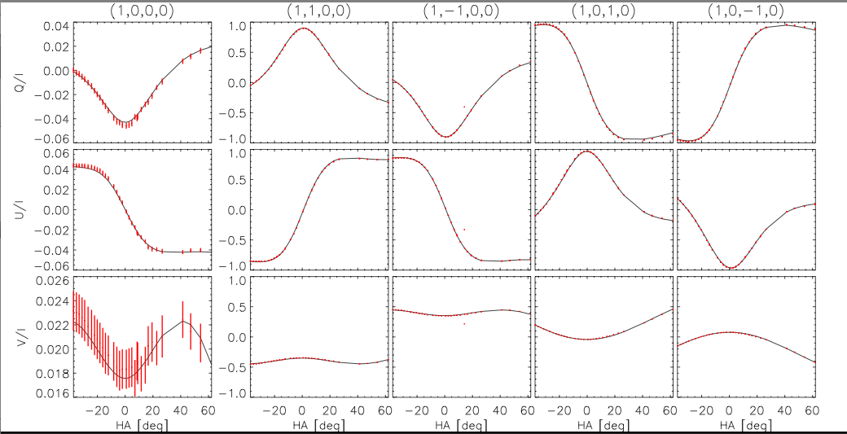
e.g.) CaⅡ8542 Å
Red : observation
Black : DST model
(1,0,0,0)
Q=U=V=0
(1,1,0,0)
(1,−1,0,0)
(1,0,1,0)
(1,0,−1,0)
1
I = +Q
I = −Q
I = +U
I = −U
0.04
Q/ I
0.00
0
−0.04
−1
1
0.04
U/ I
0.00
0
−0.04
−1
1
0.024
V/ I
0
0.020
0.016
−1
−20
0
20
40
60
−20
0
20
40
60
−20
0
20
40
60
−20
0
20
40
60
−20
0
20
40
60
HA [deg]
HA [deg]
HA [deg]
HA [deg]
HA [deg]
Disk center,
Quiet region, continuum
p_{N}=−0.050、τ_{N}=346°.0、p_{C}=0.003、τ_{C}=27°.5 + stray 3%
Fitting residual 〜 0.001 at I²>>Q²+U²+V²
30/43

Slide 31
Diagnosis of Magnetic and Electric Fields of Chromospheric Jets through Spectropolarimetric Observations of HI Paschen Lines
Anan, Casini, & Ichimoto accepted for publication in ApJ

Slide 32
Observation
Hα core slit-jaw movie
2012, May 5
IQUV spectra in the neutral hydrogen Paschen lines (8200 – 10050 Å)
Polarization sensitivity : 〜3×10⁻³
Integration time : 〜 50 sec
Spatial resolution : 〜 2 arcsec
50,000 km
32/43
Notes:
To diagnose magnetic and electric fields of chromospheric jets, we observed some tiny jets and a surge on 2012 May 5.
This is solar limb…..
We obtained IQUV spectra in the neutral hydrogen Paschen lines.

Slide 33
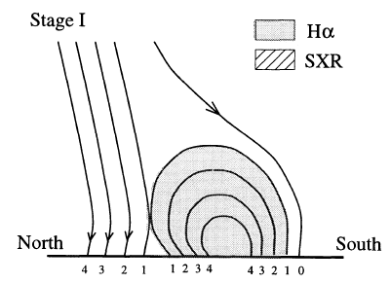
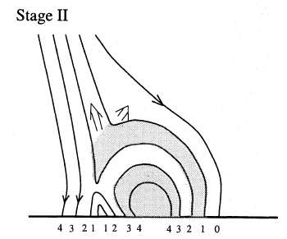
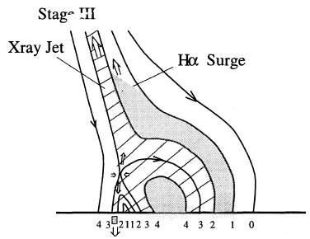
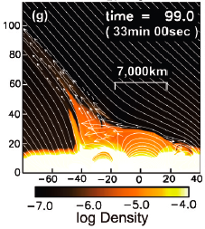
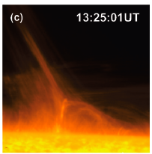
Model of surge (jet)
Surge
Canfield et al. 1996
HINODE
Magnetic field have
not yet been observed
E 〜35 V/cm
(Foukal & Behr 1995)
Nishizuka et al. 2008
33/43

Slide 34
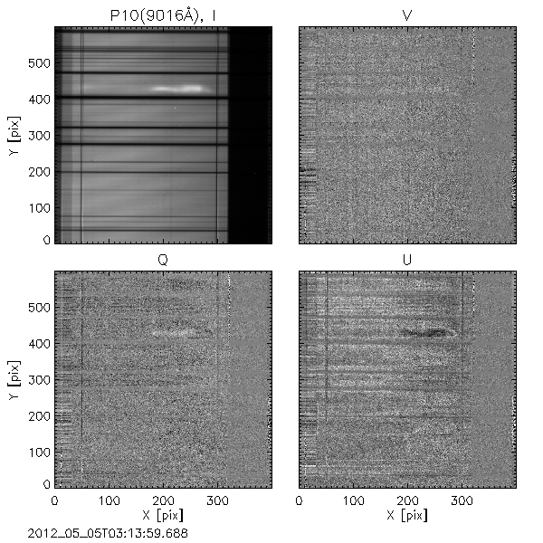
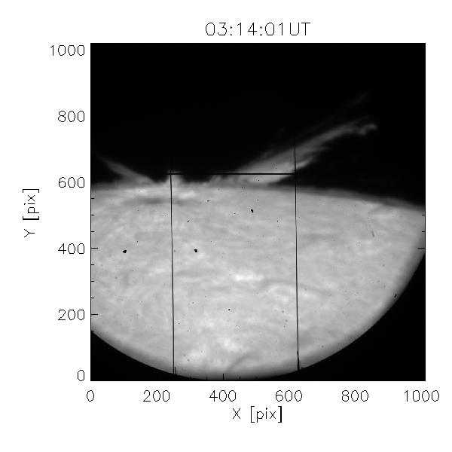
HⅠ（n=10 => n=3, 9014Å）
I
V
Intensity
−
3:13 UT
λ
Q
U
−
−
λ
50”
Slit
Slit
+Q is parallel to solar limb
34/43

Slide 35
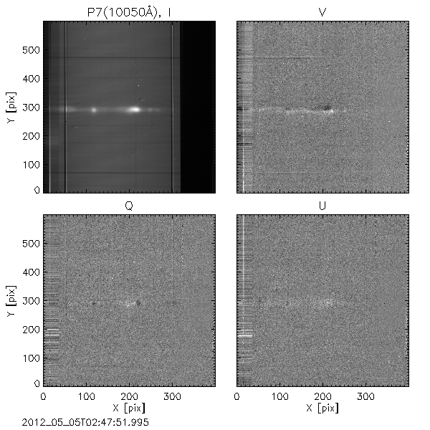
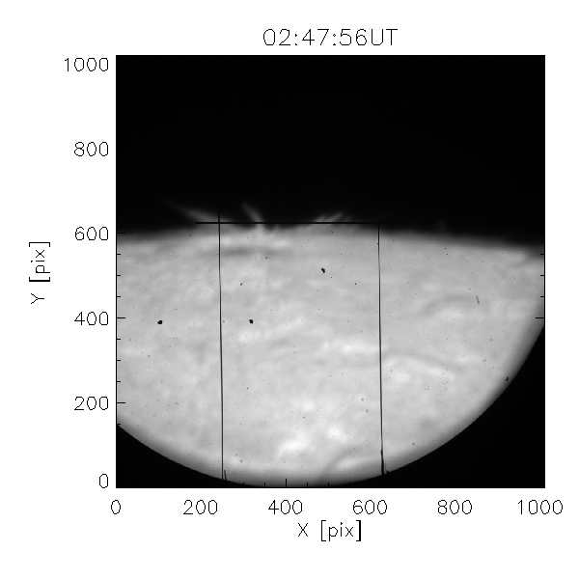
HⅠ（n=7 => n=3, 10049Å）
I
V
Intensity
−
2:47 UT
λ
Q
U
−
−
λ
50”
Slit
Slit
+Q is parallel to solar limb
35/43

Slide 36
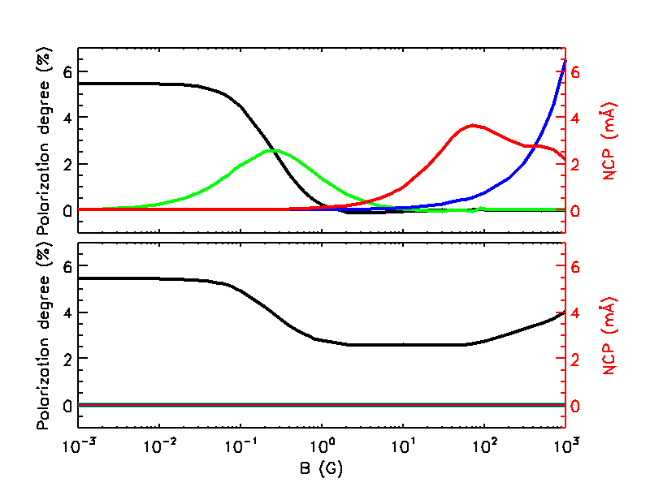
Polarization process in the HI Paschen lines
Scattering
Hanle effect
Paschen-Back effect (Zeeman)
B
Q
Alignment - orientation
observer
U
NCP
source
V
B
Scattering polarization
in level crossing
Q
observer
U
V
NCP
source
B（G）
Stark effect, electric Hanle effect, & electric A-O
36/43
Notes:
Here I’d like to introduce polarization process in the Paschen series of neutral hydrogen which we observed
縦軸横軸
Both plot is in 90deg scattering case.
Upper panel is B directs to the observer
それぞれ
In addition to the magnetic field effect, the line is sensitive to electric field.
Because linear Stark effect works on only hydrogen-like ion and the splitting energy levels by Stark effect is roughly proportioanl to a squre of principle quantum number.

Slide 37
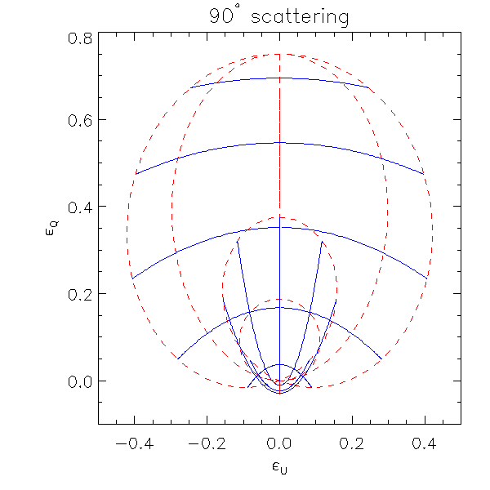
180°, 90° ambiguity in azimuth angle of B
Emissivity in Hanle saturation regime
90° scattering
0.8
θ_{B} = 10°
ε_{Q}
20°
Casini 2002
0.4
90°
80°
B
30°
Line of sight
70°
90° ambiguity
occur
0.0
40°
50°
60°
−0.4
0.0
0.4
ε_{U}
Incident light
37/43
Notes:
In choromosphere, it is in almost Hanle saturation regime.
There is 90degree ambiguity in azimuth angle
This show the definition of the angle in this presentation, 方位角の説明
In hanle saturation regime, emissibity can be written as
And right plot the emissivities in 90 deg scattering
A change of sign of Stokes Q and U introduced by a 90deg change of ΦB can be conpensated by a change of sign of the factor ??
It means different magnetic configuration produce same Stokes vector
In right plot, its corresponds in this region
we will present whether the inversion result has the 90deg ambiguity or not by checking the formula

Slide 38
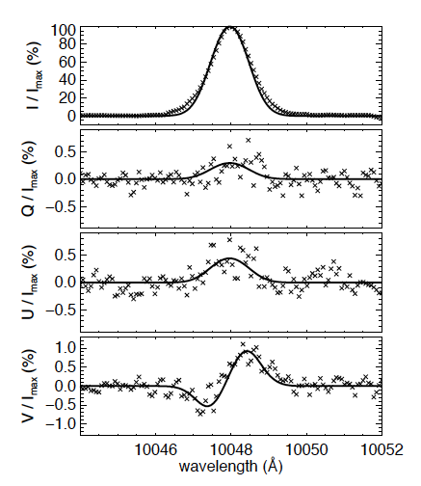
Fitting
Fitting only with B field
Method: López Ariste & Casini 2002
Scattering
Hanle effect
⬄Direction of B
M=−1
M=0
M=1
J=0, M=0
Zeeman effect ⬄ B_{LOS}
Alignment - Orientation
=>Upper limit of E field
Considering atomic polarization
ignored in previous studies
38/43
Notes:
電場があると、どうなるか！！

Slide 39
If enough electric field exist,
Stark effect + atomic polarization
39/43
Notes:
If electric field strength is enough strong to detect the polarization signal,
Stark effect produce such kind of Stokes profile and atomic polarization produce large polarization degree which would be not fitted only with magnetic field effect.

Slide 40
Inversion result
Not have 90° ambiguity
In 90° ambiguity condition
0
20
40
60
80
0
20
40
60
80
0
20
40
60
80
0
20
40
60
80
0
(arcsec)
(arcsec)
(arcsec)
(arcsec)
The surge reached
its maximum length
No apparent motion
=> V_{n} = V_{Doppler}
B
10〜640G
Surge
E
v_{n}
Limb
40/43
Notes:
60-630G, 190-960G, 40-200G

Slide 41
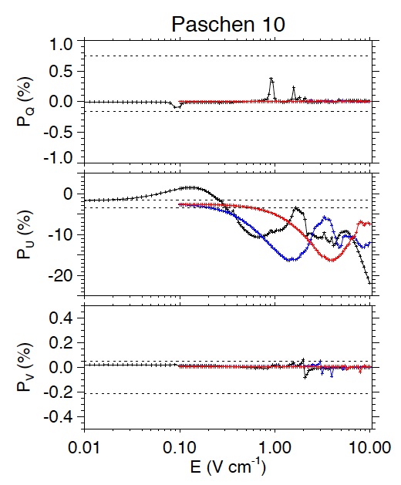
Upper limit of electric field (V_{n}−V_{c})×B/c
V_{Doppler} × B/c
Paschen 10 (3:13UT)
1.0
Observation
P_{Q} (%)
0.0
−1.0
0
70 G
200 G
600 G
P_{U} (%)
−10
−20
0.4
P_{V} (%)
0.0
−0.4
0.01
0.10
1.00
10.00
E (V/cm)
41/43
Notes:
At 3:16UT, the surge reached the maximum length

Slide 42
Summary
To open a new window of plasma diagnostics, we developed a spectropolarimeter of Domeless Solar Telescope at Hida obs.
Polarization sensitivity 10⁻³ - 10⁻⁴ for 4000 - 11000Å
Diagnosis of the magnetic field and the electric field of a surge with a spectropolarimetric observation in the Paschen neutral hydrogen lines with consideration of atomic polarization
As results
We measured magnetic field and upper limit of electric field
the magnetic field approximately align to the surge
Velocity deference between neutral atoms and charged particles was below the velocity of bulk neutral atom motion => Neutral atoms are dragged by magnetic field
42/43

Slide 43
Thank you very much
Notes:
まとめに戻す

